Slide 1


Inclusive and Accessible Design in the Power Platform – Starter Pack!
Thu 22 Sep | 8:00am
Kristine Kolodziejski
Technical Architect
Kristine.Kolodziejski@gmail.com

Slide 2
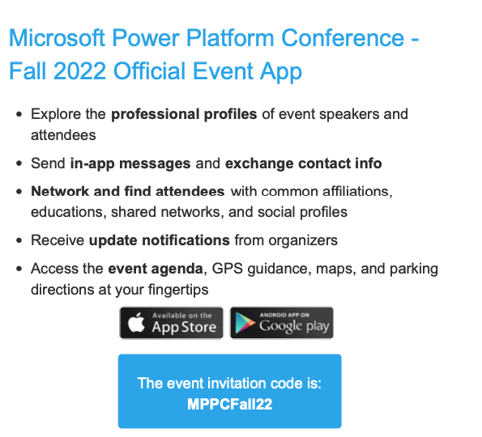

Slide 3




Upskilling for Career Switchers
POWER BI
POWER AUTOMATE
POWER APPS
POWER VIRTUAL AGENTS
POWER PAGES
A brand-new upskilling program for people from non-technical backgrounds, to enable them to get better career opportunities.
Through guided curriculum, self-paced learnings, instructor-led training, and hands-on exercises, participants will learn new skills while being supported by the Power Platform community and Microsoft product teams.
aka.ms/MSPowerUp

Slide 4
JOIN THE COMMUNITY
POWER BI
POWER AUTOMATE
POWER APPS
POWER VIRTUAL AGENTS
POWER PAGES
Discover the difference being part of the Microsoft Power Platform Community can make for you. With the latest News & Announcements, Forums, Microsoft-empowered User Groups, events, and more, you’ll find out why we believe in the power of community. Whether you’re a super user or just getting started, discover why we believe #CommunityRocks!
aka.ms/JointheCommunity

Slide 5


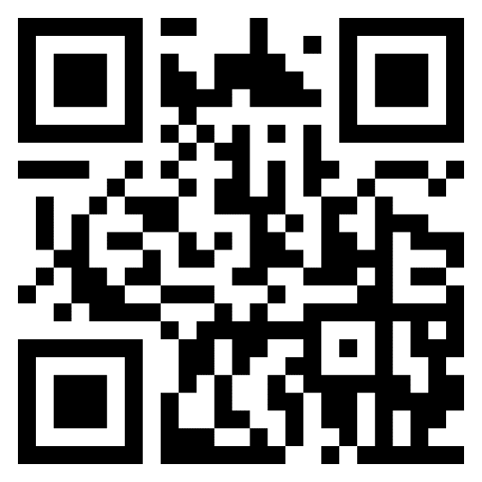
About me
13x Microsoft Certified Professional in Azure, Power Platform and M365
UX/UI obsessed
Active community contributor
Blogger
Avid gamer and dog mum
Technical Architect
Computacenter
London, UK

Slide 6




Mind-blowing stats
of the world population has a permanent disability
of disabled users experienced issues with apps and websites
of those users will also click away from your app/website if it’s problematic
of the world population has a permanent disability
of disabled users experienced issues with apps and websites
of those users will also click away from your app/website if it’s problematic
of all websites checked for accessibility had major issues
15%
71%
15%
73%
73%
71%
70%
01
01
01
01
01

Slide 7
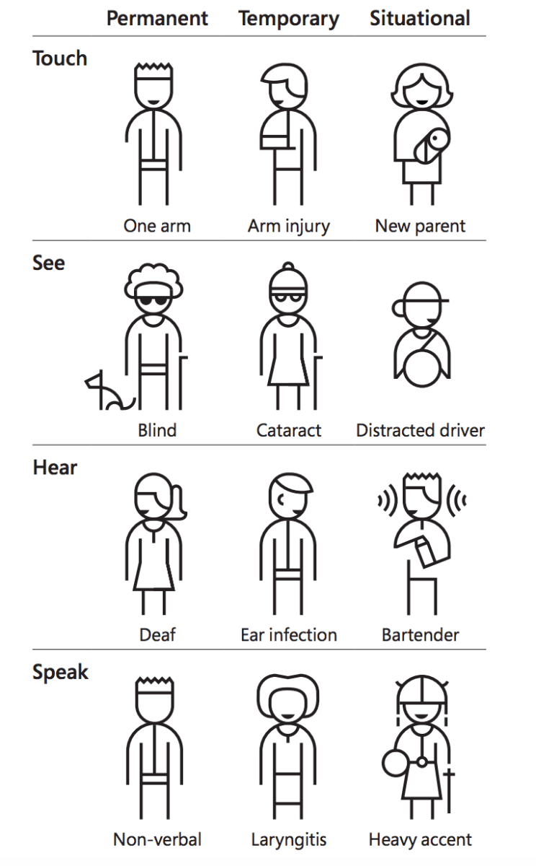
Types of accessibility

Slide 8










Accessibility across the Power Platform
Colour contrasts
Focused borders
Alternative text
Logical layout
Keyboard navigation
Easy to understand

Slide 9

Demo time!

Slide 10

Real-life example
Notes:
Photo by Anna Shvets from Pexels
Photo by Sora Shimazaki from Pexels

Slide 11
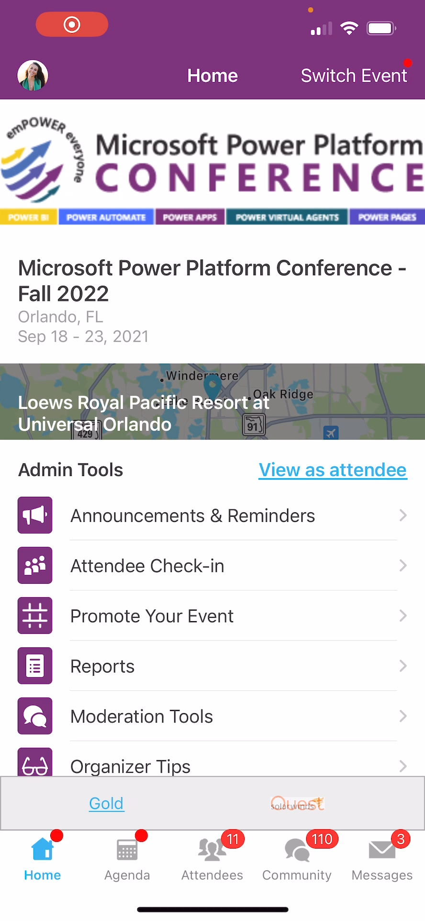
Session Feedback Surveys
In the pursuit of making next year’s Microsoft Power Platform Conference even better, we really want to hear your feedback about this session.
Here’s How -
Simply go to the Whova App on your smartphone
Go to the Microsoft Power Platform Conference event
Scroll down on the homepage to ‘Additional Resources’ and click ‘Surveys’.
Click ‘Session Feedback’.
Scroll down to click on this session title.
Complete the session feedback survey.
Finally, click ‘Submit’

